Slide 1
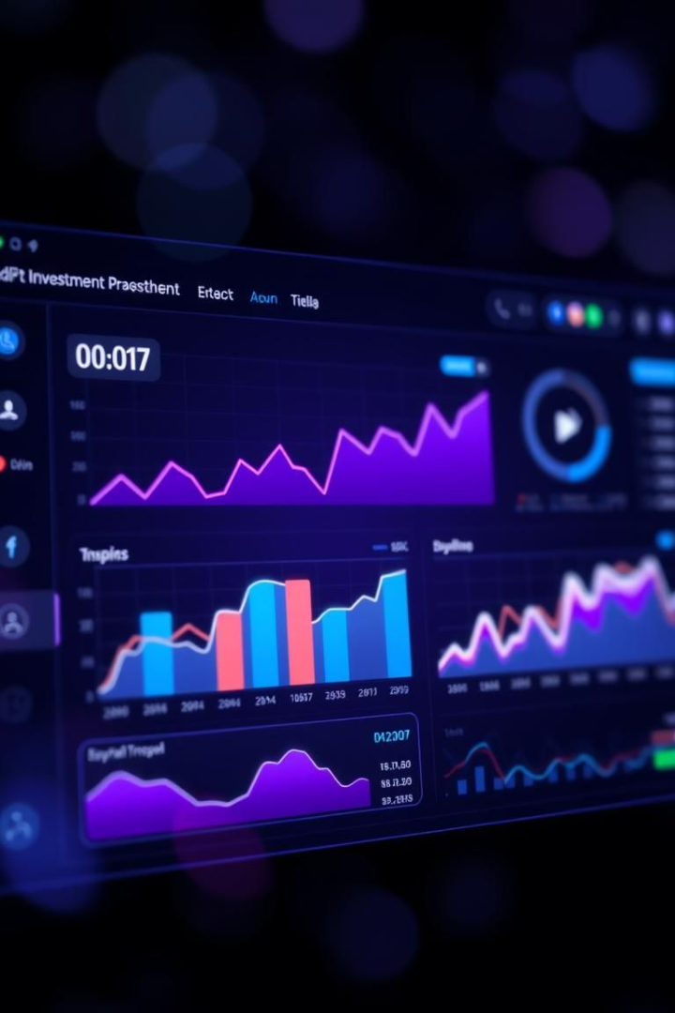
AI-Powered Investment Dashboard: Invest Smarter, Not Harder
Traditional investment methods can be time-consuming, complex, and often lead to suboptimal decisions. Our AI-driven dashboard simplifies investing, providing real-time insights, and empowering users to make informed choices.
Unlock your investment potential with our cutting-edge platform. Experience the future of investing today.

Slide 2
Navigating the Complex World of Investing
Information Overload
Time-Consuming Research
Emotional Decision-Making
Investors face an overwhelming amount of data from various sources, making it difficult to discern valuable insights. Sifting through daily news reports, financial statements, and expert opinions is challenging.
Conducting thorough market research and analysis requires significant time and effort. The average investor spends 10+ hours per week researching investment opportunities.
Human emotions can lead to impulsive and irrational investment choices, such as panic selling during market downturns or chasing short-term gains based on hype.

Slide 3
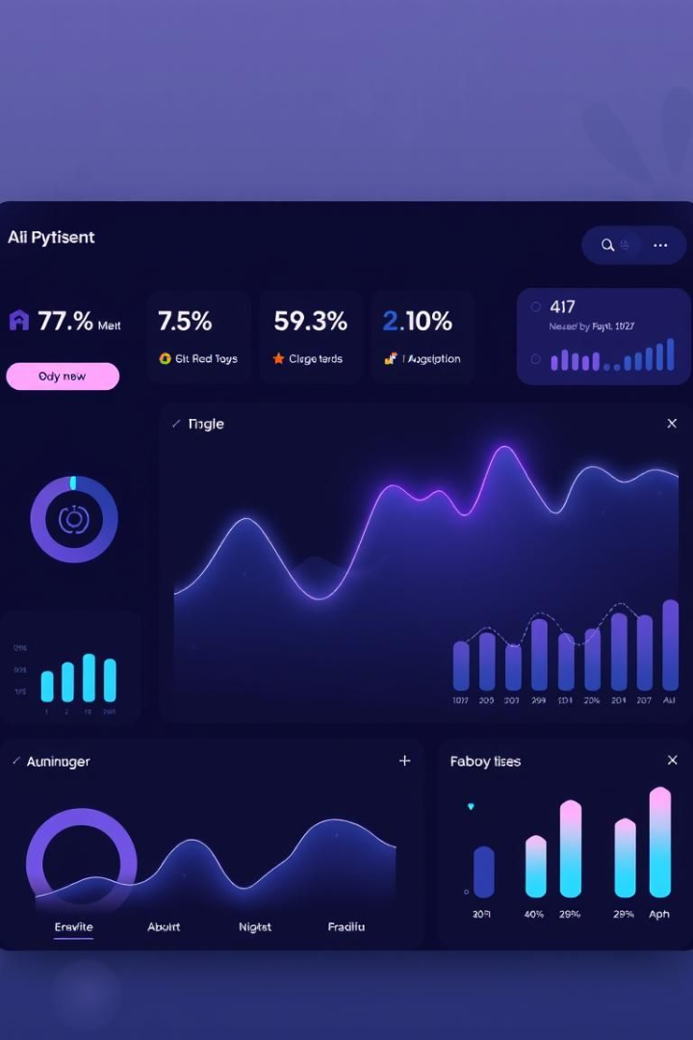



Our Solution: An AI-Powered Investment Dashboard
Real-time Data Aggregation
AI-Driven Insights
Leverages machine learning algorithms to identify trends, predict market movements, and generate personalized recommendations.
Consolidates market data, news feeds, and expert analysis into a single, intuitive platform for easy access.
Simplified Investing Experience
Streamlines the investment process, making it accessible to both novice and experienced investors alike.

Slide 4
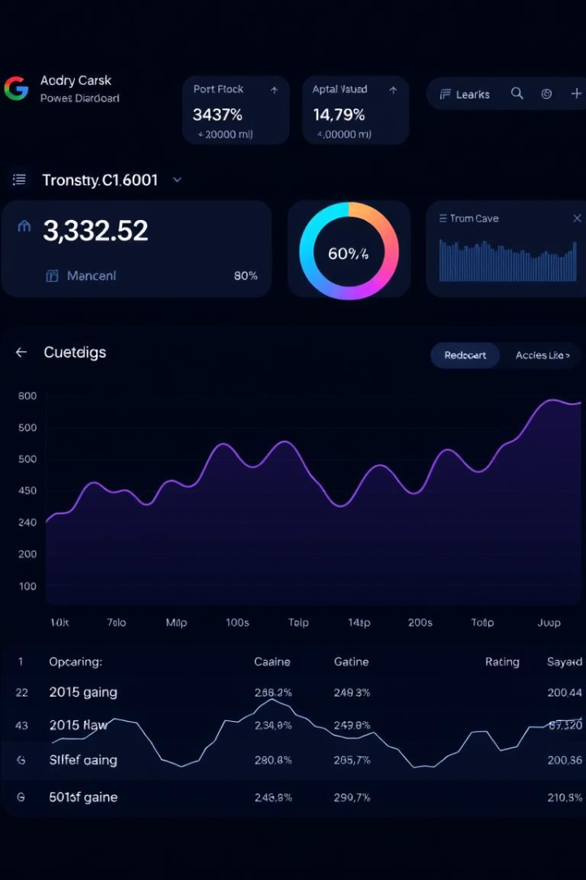



Real-Time Portfolio Tracking
Comprehensive Overview
Provides a clear and concise view of your investment portfolio performance, tracking gains, losses, asset allocation, and overall value.
Customizable Dashboards
Tailor the dashboard to display the information that matters most to you, ensuring a personalized experience.
Alerts and Notifications
Receive timely alerts about significant market events or portfolio changes, such as price drops, earnings announcements, or dividend payouts.

Slide 5

AI-Powered Advisory
Personalized Recommendations
Predictive Analytics
Utilizes machine learning algorithms to forecast market trends and identify potential investment opportunities, leveraging time series analysis and regression models.
Generates investment recommendations based on your risk tolerance, financial goals, and current market conditions, tailored to your unique needs.
Portfolio Optimization
Suggests adjustments to your portfolio to maximize returns and minimize risk, ensuring a balanced and strategic approach to investing.

Slide 6
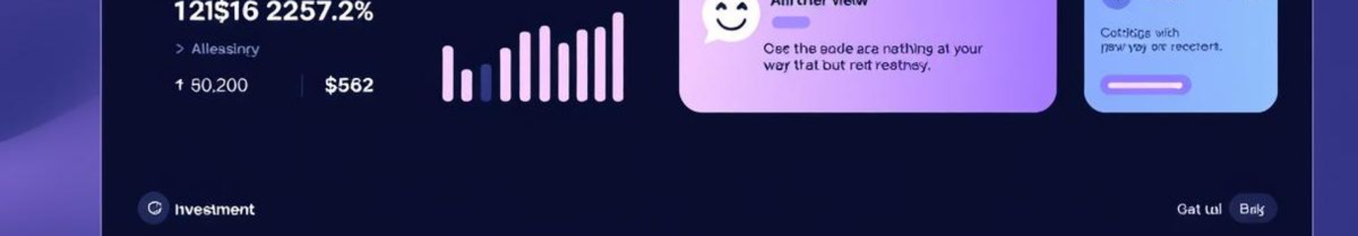



Intelligent Chatbot
24/7 Support
Provides instant answers to your investment questions and concerns, ensuring you always have access to assistance.
Natural Language Processing
Understands and responds to your queries in a conversational manner, making it easy to get the information you need.
Personalized Guidance
Offers tailored advice and support based on your investment profile, providing customized solutions for your specific needs.

Slide 7



Advanced Risk Assessment
Risk Scoring
Assigns a risk score to each investment option, allowing you to make informed decisions based on your individual risk preferences.
Risk Profiling
Assesses your risk tolerance based on a comprehensive questionnaire, providing a clear understanding of your investment comfort zone.
Stress Testing
Simulates the impact of various market scenarios on your portfolio, such as economic recessions or market crashes.
2
1
3

Slide 8
Tech Stack: Powering the Future of Investing
Frontend: React.js
AI/ML: Groq API
Dynamic and responsive user interface for a seamless and engaging experience.
Lightning-fast AI inference and real-time recommendations, delivering up to 20x faster inference than traditional GPUs.
Backend: Node.js
Data Integration: Angel One API
Scalable and efficient server-side logic for optimal performance.
Seamless access to market data and trading capabilities with real-time streaming data and millisecond latency.

Slide 9

Impact: Transforming the Investment Landscape
Improved Investment Outcomes
Empowers investors to make smarter decisions and achieve their financial goals, leading to better returns and financial security.
Increased Efficiency
Automates time-consuming tasks, freeing up investors to focus on other priorities and enjoy a more streamlined investment process.
Democratized Access
Makes sophisticated investment tools and insights accessible to a wider audience, fostering greater financial literacy and inclusion.

Slide 10

Invest Smarter with Our AI-Powered Dashboard
Our AI-driven solution addresses key investment challenges, providing real-time insights, personalized recommendations, and advanced risk assessment.
Sign up for a demo today and experience the future of investing firsthand. Unlock your investment potential and achieve your financial goals with our innovative platform.
Thank you for your time. For more information, please visit our website or contact us directly.

